Slide 1

Asynchronous? Parallel? Reactive? HELP!
CodeMash, 2015

Slide 2
Who is this guy?

Slide 3


Slide 4
Concurrent Terminology

Slide 5
Terminology
Concurrent
Dataflow
Reactive
Multithreaded
Rx
Task.Run
Asynchronous
Parallel
Async/Await
PLINQ, Parallel
Notes:
This slide is mostly about terminology, and there’s no definite standard or consensus yet.
I prefer to use the term “concurrency” for multiple things happening at the same time (e.g., DB/UI, ASP.NET server requests).
Most people immediately think of multithreading.
Multithreading is one way to get concurrency; e.g., ASP.NET will handle multiple requests on different threads by default.
“Parallelism” is parallel processing, one type of multithreading. E.g., Parallel LINQ and the Parallel Task Library.
Most parallelism does the same calculation for many pieces of data.
Asynchrony is a way to get concurrency without multithreading. E.g., freeing up the calling thread instead of blocking it while an I/O operation is in progress.
Asynchrony is one form of Reactive programming. “Reactive” just means your app reacts to events.
The technologies we’re talking about coordinate with these categories.

Slide 6

When to Use What: 3 Questions
Is the code CPU-bound or I/O-bound?
CPU-bound -> Task.Run and/or Parallel.
I/O-bound -> async and/or Rx.
Mix -> Dataflow, or a mixture (Rx + Parallel, async + Task.Run).

Slide 7

When to Use What: 3 Questions
What’s the natural structure of the code?
Doing a single operation -> Task.Run, async.
“Pull”: start with completion notification, single result
Processing a stream -> Rx, Dataflow.
“Push”: subscribe and receive updates.

Slide 8

When to Use What: 3 Questions
What’s the context (UI/ASP.NET/other)?
ASP.NET
Avoid Parallel
Avoid Task.Run
Dataflow questionable.
UI
Task.Run good for doing work off the UI thread.
All contexts are good for async, Rx.
Notes:
“Other” context is becoming more common (WebJobs, also Console, Win32 services).
ASP.NET: instead of doing your own parallel code, embrace the parallelism already provided by the platform.

Slide 9
Multithreading

Slide 10
Multithreading
Concurrent
Reactive
Multithreaded
Task.Run
Asynchronous
Parallel

Slide 11

Multithreading?
Multiple threads?
new Thread();
BackgroundWorker
X
Multiple tasks
Just let the ThreadPool manage the threads for you!
Task.Run for simple stuff.
Notes:
Think in terms of tasks, not threads. You have one (or many) tasks you need to do.
The ThreadPool will inject (or remove) threads as necessary, and it has work-stealing queues, heuristics to maximize cache hits per processor, and all kinds of stuff like that.
Just TRUST the awesomeness of the built-in thread pool; have faith that it will work. You can always tweak it if you really need to.
Bare multithreading is almost never necessary. Multiple threads should be replaced by modern techniques: Task.Run for simple stuff, Parallelism for CPU-bound parallel algorithms, TPL Dataflow for more advanced scenarios.

Slide 12
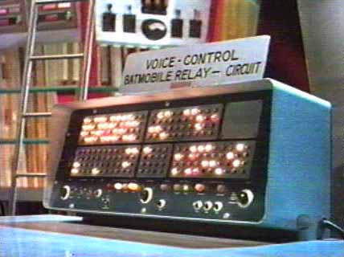
Multithreading Demo
So you won’t forget, Steve.

Slide 13
Parallel Programming

Slide 14
Parallelism
Concurrent
Reactive
Multithreaded
Asynchronous
Parallel
PLINQ, Parallel

Slide 15

Parallel Programming
Data parallelism
Identical processing over large data sets.
LINQ/for/foreach.
Task parallelism
Set of operations to execute.
Method calls: f1(); f2(); f3();
Dynamic parallelism
Divide-and-conquer at runtime or recursive structures.
Notes:
Parallel programming is a way to abstract even further and – if possible – let a library create the tasks for you.
All operations should be Independent (as much as possible). Refactor to remove shared data. Use locks as a last resort.
You could consider Dynamic Parallelism as a form of Task Parallelism.

Slide 16

Data Parallelism
Original code: LINQ, for, foreach
Parallel eqivalents: PLINQ, Parallel.For, Parallel.ForEach
ParallelLoopState.Stop (and Break)
Aggregation: PLINQ (Sum, etc)
Notes:
The vast majority of Parallel code will use Data Parallelism.
Stop will stop executing a loop. Break will stop executing a loop after all “earlier” data has been processed.

Slide 17
Task Parallelism
Original Code: f1(); f2();
Parallel translation: Parallel.Invoke(f1, f2);
May switch to data parallelism for performance reasons:
Each delegate becomes a data item.
The action to perform is executing the delegate.
Notes:
f1/f2 can be, say “process the left branch of the binary tree” and “process the right branch of the binary tree”.
Parallel.Invoke can take any number of delegates.

Slide 18
Dynamic Parallelism
Divide-and-conquer or recursive structures.
Commonly uses parent/child tasks.
Task.Factory.StartNew
http://msdn.microsoft.com/en-us/library/ff963551.aspx
Notes:
This is the only modern scenario where Task.Factory.StartNew should be used.
StartNew is very commonly misused on the Internet (most should use Task.Run instead).
E.g., doing some action for every node of an unbalanced tree or graph.

Slide 19

Parallel Demo
So you won’t forget, Steve.

Slide 20
Asynchronous Programming

Slide 21
Asynchrony
Concurrent
Reactive
Multithreaded
Asynchronous
Parallel
Async/Await
Notes:
Asynchronous processing is all the rage these days. Async/await FTW!
Async excels at I/O, but you can treat anything as async.
This section is a bit longer: it’s a newer technology that is widely applicable.

Slide 22
Asynchronous Tasks
async Task<int> TestAsync() { await Task.Delay(100); return 13; }
Notes:
A Task completes exactly once, either successfully (with result) or error.
When await is passed an incomplete task, it pauses the current method’s execution and returns an incomplete task.
Pauses the method, not the thread.
Later, when the task argument completes, it resumes executing the method (by default, in the same context, or on the thread pool if no context).
Async is about freeing up the current thread, not using background threads.

Slide 23
Introduction to Async
async Task DoNothingAsync()
{
// In the Real World, we would actually do something...
await Task.Delay(100);
}
Notes:
Let’s dive right in. This is the real syntax for the async and await keywords.

Slide 24
Introduction to Async
async Task DoNothingAsync()
{
// In the Real World, we would actually do something...
await Task.Delay(100);
}
The async keyword:
Enables the await keyword for that method.
Transforms the method into a state machine, very similar to the yield keyword.
That’s it!
Notes:
The async keyword can only be applied to a method.
Details of the transformation are not important; just be aware that there is a transformation going on.
An async method does not mean it runs on a thread pool thread.
When you call an async method, it starts executing synchronously.

Slide 25
Introduction to Async
async Task DoNothingAsync()
{
// In the Real World, we would actually do something...
await Task.Delay(100);
}
async Task DoNothingAsync()
{
Task delay = Task.Delay(100);
await delay;
}
await
Takes a single argument.
“Awaitable”
Usually a Task or Task<T>.
Notes:
“Await” is like a unary operator; it takes a single argument (like a cast).
This argument is an “awaitable”. I won’t get into the specifics, but an “awaitable” is a type that matches a certain pattern (similar to how foreach works).
An “awaitable” represents an asynchronous operation. In this talk, all our “awaitables” are Task objects.
Technically, you don’t “await” a method; you call the method and then “await” the Task it returns. But “await a method” and “awaitable method” are common phrases.
- Another method can await the task returned from DoNothingAsync, not b/c the method is async, but b/c it returns a Task.
Async methods start synchronously; so this method will (synchronously) call Task.Delay and then await.
Await is where things can start to get asynchronous.

Slide 26

Introduction to Async
async Task DoNothingAsync()
{
// In the Real World, we would actually do something...
await Task.Delay(100);
}
await behavior:
If awaitable (task) is complete, continues synchronously.
Otherwise:
Pauses the method and registers it with the awaitable.
Then returns.
Notes:
The “registering” is saying, “when you complete, please resume this method”.
When DoNothingAsync returns, it returns an incomplete Task.
The returned Task represents this method; when this method completes, it will complete the Task.

Slide 27

Introduction to Async
async Task DoNothingAsync()
{
// In the Real World, we would actually do something...
await Task.Delay(100);
}
Pausing and Resuming (when awaiting tasks)
A “context” is captured and used to resume.
“await” = “asynchronous wait”
Thread is not blocked (asynchronous).
Method is paused (waits).
Notes:
In ASP.NET the “context” is the request context (HttpContext.Current, identity, and culture).
In this example, if you have the request context before the await, then you’ll have it after the await.
Request context only allows one thread at a time.
Technically: SynchronizationContext.Current or TaskScheduler.Current.

Slide 28
Introduction to Async
Return types for async methods: Task or Task<T> (or void)
Avoid async void.
async Task<int> DoNothingAsync()
{
await Task.Delay(100);
return 42;
}
async Task DoNothingAsync()
{
await Task.Delay(100);
}
Notes:
An async method may return Task or Task<T> (or void).
Use async Task if you have nothing to return.
Use async Task<T> if you have a return value.
- Note that the return type is int while the method return type is Task<int>. You don’t return a task object directly if the method is marked async.
Avoid async void.

Slide 29
Introduction to Async
Follow the Task-based Asynchronous Pattern (TAP):
http://msdn.microsoft.com/en-us/library/hh873175.aspx
Naming: MyMethodAsync
Cancellation:
Take a CancellationToken parameter.
Pass the token through to other methods.

Slide 30
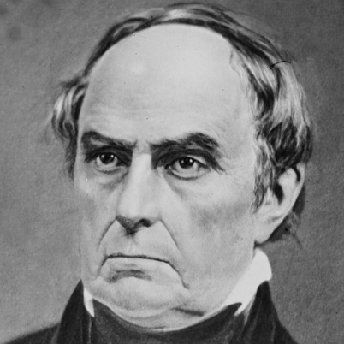
Asynchrony != Multithreading
“UNTHREAD’ING, ppr. Depriving of a thread.”
Webster’s Dictionary (1828)
Daniel WebsterD
Notes:
Asynchrony is a form of concurrency without using threads.
Instead, asynchronous code registers a callback/future as a “bookmark” and frees the current thread to do other work.

Slide 31
There Is No Thread
My code
Task
IOCP
BCL/library
OVERLAPPED
APC
OS
User mode
Kernel mode
IRP
DPC
Device driver
ISR
Notes:
This is the ideal I/O scenario for .NET I/O that uses the standard IOCP/OVERLAPPED system.
IRP = I/O Request Packet
ISR = Interrupt Service Request
DPC = Deferred Procedure Call
APC = Asynchronous Procedure Call
IOCP = I/O Completion Port

Slide 32
Task: The Great Confusion
Promise Tasks
Primarily used by Asynchronous code.
Represents an event or signal.
Delegate Tasks
Primarily used by Parallel code.
Has code (delegate) to run; is scheduled, etc.
Notes:
For TPL devs: Task (as used by the TPL) is completely different than Task (as used by async).
For newbie devs: Task has a lot of baggage from the TPL; most members should just not be used.

Slide 33
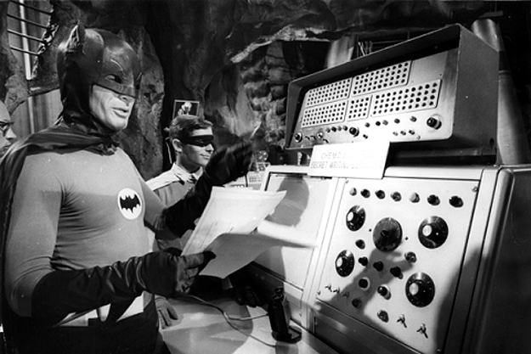
Async Demo
So you won’t forget, Steve.

Slide 34
Dataflow

Slide 35

Dataflow
Concurrent
Dataflow
Reactive
Multithreaded
Asynchronous
Parallel
Notes:
Dataflow doesn’t really fit into this slide. IT GOES EVERYWHERE!
Dataflow’s all like “hey, I’m Reactive and Asynchronous and Multithreaded and Parallel! Whaaat?”
That means it’s got tons of buttons and crazy options for doing practically anything. And it also goes really fast.

Slide 36

Blocks
Blocks are source, target, or both (propagator).
Blocks can produce/receive data sync/async.
Source blocks link to target blocks.
“Mesh”: A directed graph of blocks. Usually a pipeline, but is capable of forks, joins, and loops.

Slide 37
More on Blocks
Sort of like actors, but not a full-blown actor framework.
Input buffer and independent task(s).
Notes:
Blocks are very independent by default.

Slide 38

Common Block Types
TransformBlock<TInput, TOutput> - Select
TransformManyBlock<TInput, TOutput> - SelectMany
ActionBlock<T> - foreach
BufferBlock<T> - async-friendly
producer/consumer queue
Notes:
“Fork” blocks include BroadcastBlock and WriteOnceBlock.
“Join” blocks include BatchBlock, JoinBlock, BatchedJoinBlock.

Slide 39

Common Block and Link Options
MaxDegreeOfParallelism – concurrency within a block.
BoundedCapacity – throttling.
Links: PropagateCompletion
void Complete();
Task Completion { get; }
Notes:
Call Complete() on the first input block when you’re done sending data.
Wait for the Completion task on the last output block to ensure it’s all done.
PropagateCompletion propagates errors, too.

Slide 40

Dataflow Demo
So you won’t forget, Steve.

Slide 41
Reactive (Rx)

Slide 42
Reactive Extensions (Rx)
Concurrent
Reactive
Multithreaded
Rx
Asynchronous
Parallel

Slide 43

The Problem with Rx
Rx is extremely powerful.
But it’s hard to learn.
Notes:
Feels like an uphill climb.

Slide 44
Rx Observables
LINQ over events. Push instead of Pull.
Anatomy of an Observable stream (IObservable<T>):
Any number of data events: OnNext.
May end with a success event: OnCompleted.
May end with a fault event: OnError.
May not end at all.
Notes:
Rx treats events as a data source.
The standard IEnumerable is a Pull system; the foreach loop pulls each data item out of the sequence.
Observables are a Push system; the system reacts to the data items as they arrive.

Slide 45

Rx subscriptions
Subscriptions provide callbacks for OnNext / OnCompleted / OnError.
Hot and cold observables:
Cold sequences start when they’re subscribed to.
Hot sequences are always running; if no subscribers, events are lost.
Notes:
Cold sequences are like an HTTP request; the subscription causes the request to be sent.
Hot sequences are like mouse movements; they are always going on, even if no one is subscribed.

Slide 46
Rx Example
var timestamps = Observable
.Interval(TimeSpan.FromSeconds(1))
.Timestamp()
.Where(x => x.Value % 2 == 0)
.Select(x => x.Timestamp);
var subscription = timestamps
.Subscribe(x => Console.WriteLine(x),
ex => Console.WriteLine(ex));
Notes:
Standard LINQ operators such as Where and Select work as expected.
Also as a demo!

Slide 47

Rx and Events
Observable.FromEventPattern – convert events to observables.
ObserveOn – “move” stream to a context (e.g., UI or ThreadPool).
Commonly used with SynchronizationContext.
Actually uses an “Rx Scheduler”.
Notes:
Observables are what events really should be:
Clean, disposable subscriptions.
Well-defined threading semantics (e.g., no EBAP necessary) including shutdown semantics (unsolvable problem for raw events).
The Rx Scheduler abstraction is used in unit testing.
All of Rx was designed to be unit testable. Testing FTW!

Slide 48

Rx and Time
Filtering fast input based on time:
Throttle – sliding timeout window.
Sample – periodic timeout window.
Grouping fast input based on time or amount:
Buffer – group inputs into IList<T>.
Window – group inputs into IObservable<T>.
Notes:
Rx really shines when it comes to time!
Throttle: When an incoming event arrives, it resets the timeout window. When the timeout window expires, it publishes the last event value that arrived within the window.
Sample: Establishes a timeout period, and publishes the most recent value within that window each time the timeout expires. If there were no values received within the sample period, then no results are published for that period.

Slide 49
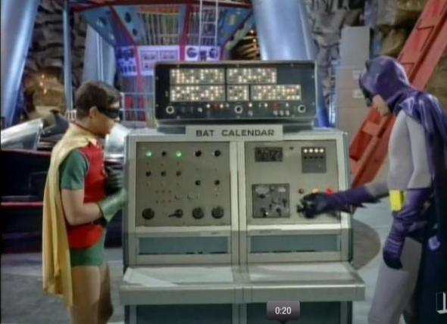
Rx Demo
So you won’t forget, Steve.

Slide 50

Bonus Round

Slide 51
Interop
Treating Parallel as Async: Task.Run
Dataflow to Rx: block.AsObservable()
Rx to Dataflow: block.AsObserver()

Slide 52
Interop
Rx over Async:
Task.ToObservable()
Observable.StartAsync – supports cancellation
Observable.FromAsync – starts operation on subscription
SelectMany – starts operation for each data item
Async over Rx:
await observable – returns last data item.
Also: FirstAsync, LastAsync, ToList.

Slide 53

Resources

Slide 54
Where to Get the Good Stuff?
 | .NET 4.5 | Xamarin | WinStore | WPA81
Parallel | Built-in | Built-in | Built-in | Built-in
Async | Built-in | Microsoft.Bcl.Async | Built-in | Built-in
Dataflow | Microsoft.Tpl.Dataflow | Microsoft.Tpl.Dataflow | Microsoft.Tpl.Dataflow | Microsoft.Tpl.Dataflow
Rx | Rx-Main | Rx-Main | Rx-Main | Rx-Main
Notes:
Multithreading (Task.Run) is actually part of Async in this table.
Bold items are NuGet packages.

Slide 55
Legacy Platform Support
 | .NET 4.0 | WP SL 8.0 | WP SL 7.1 | SL5
Parallel | Built-in | ☹ | ☹ | ☹
Async | Microsoft.Bcl.Async | Microsoft.Bcl.Async | Microsoft.Bcl.Async | Microsoft.Bcl.Async
Dataflow | ☹ (Unofficial) | Microsoft.Tpl.Dataflow | ☹ | ☹
Rx | Rx-Main | Rx-Main | Rx-Main | Rx-Main

Slide 56

Where do I go from here?
Parallel:
Parallel Programming with Microsoft .NET.
http://msdn.microsoft.com/en-us/library/ff963553.aspx
Sections on Futures and Pipelines are out-of-date:
Futures should use async.
Pipelines should use TPL Dataflow.
Samples:
http://code.msdn.microsoft.com/windowsdesktop/Samples-for-Parallel-b4b76364
Notes:
The slides will be available for download tonight from my blog (blog.stephencleary.com).
Samples download includes both examples from my Parallel demo.

Slide 57
Where do I go from here?
Asynchronous:
http://blog.stephencleary.com/2012/02/async-and-await.html
TPL Dataflow:
http://www.microsoft.com/en-us/download/details.aspx?id=14782
Reactive Extensions:
http://www.introtorx.com/ (Lee Campbell)
Notes:
My async intro contains links to other resources at the bottom.

Slide 58

Q&A
Go forth and be awesome!
Image from Etsy user Rosewine; used with permission
Notes:
Resources are available at StephenCleary.com - slides, example code, etc.
BOOK SIGNING TOMORROW!

